Slide 1
Enhancing N-Body Simulation Performance through Parallelism and Rust-based Quadtree Data Structure
Will, Woody

Slide 2
Outline
Problem Definition
How to formulate logic in terms of physics?
Proposal
Experiment Results

Slide 3
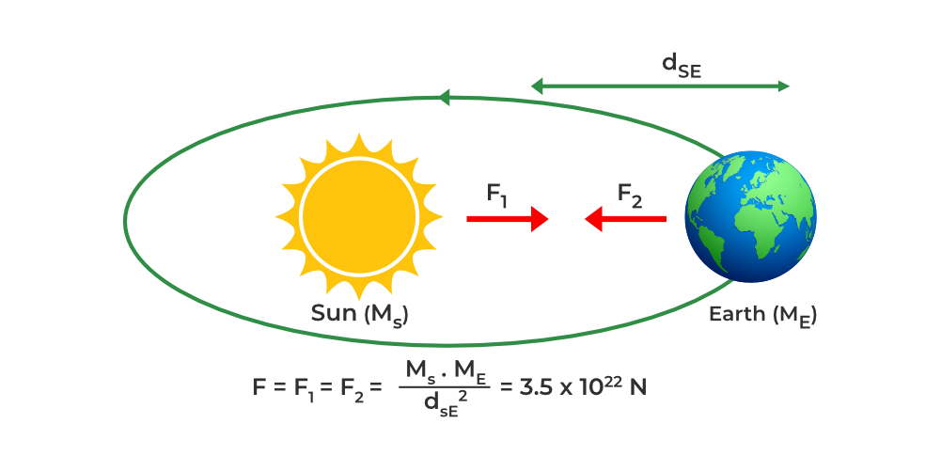
Problem Definition

Slide 4
Outline
Problem Definition
How to formulate logic in terms of physics?
Proposal
Experiment Results

Slide 5

Simple Body
Position (x, y)
Mass (m)
Velocity (vx, vy)
Acceleration (ax, ay)
Two types of impact
Collision
Non-Collision

Slide 6
Impact Handler
Due to we need to check collision for many time, we compared dist_squared <= (2 * RADIUS) * (2 * RADIUS) instead of dist <= 2*RADIUS to avoid sqrt() operation.
Collision:
Update velocities for 2 objects.
Velocities of two object after collision are opposite.
Non-Collision:
Update accelerations for 2 objects.
Acceleration of two object are opposite.
for i = 0 to universe_size - 1
for j = i + 1 to universe_size - 1
delta_x = universe[i].x - universe[j].x
delta_y = universe[i].y - universe[j].y
dist_squared = delta_x * delta_x + delta_y * delta_y
if dist_squared <= (2 * RADIUS) * (2 * RADIUS)
dot = delta_x * (universe[i].vx - universe[j].vx) + delta_y * (universe[i].vy - universe[j].vy)
scale = 2 / (universe[i].m + universe[j].m) * dot / dist_squared
universe[i].vx -= scale * delta_x * universe[j].m
universe[i].vy -= scale * delta_y * universe[j].m
universe[j].vx += scale * delta_x * universe[i].m
universe[j].vy += scale * delta_y * universe[i].m
else
scale = G / dist_squared.sqrt() / dist_squared
universe[i].ax -= delta_x * scale * universe[j].m
universe[i].ay -= delta_y * scale * universe[j].m
universe[j].ax += delta_x * scale * universe[i].m
universe[j].ay += delta_y * scale * universe[i].m
end if
end for
end for

Slide 7
Update State
Update position based on acceleration and time step (ALPHA)
x = x₀ + v₀*ALPHA + 0.5*a*ALPHA²
Update velocity based on acceleration and time step (ALPHA)
v = v₀ + a*ALPHA
Check collision with screen edges.
# Update position
i.x += i.vx * ALPHA + 0.5 * i.ax * ALPHA * ALPHA
i.y += i.vy * ALPHA + 0.5 * i.ay * ALPHA * ALPHA
# Update velocity
i.vx += i.ax * ALPHA
i.vy += i.ay * ALPHA
# Update if collision with edges
if i.x + RADIUS >= rw {
i.x = rw - RADIUS - EPSILON
i.vx = -0.5 * i.vx
}
if i.x - RADIUS <= 0.0 {
i.x = RADIUS + EPSILON
i.vx = -0.5 * i.vx
}
if i.y + RADIUS >= rh {
i.y = rh - RADIUS - EPSILON
i.vy = -0.5 * i.vy
}
if i.y - RADIUS <= 0.0 {
i.y = RADIUS + EPSILON
i.vy = -0.5 * i.vy
}

Slide 8
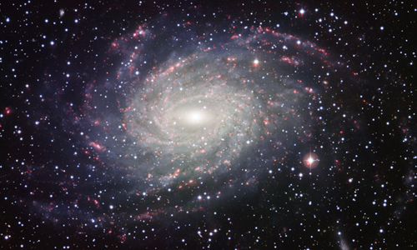
Computational Complexity Problem

Slide 9
Computational Complexity Problem
Complexity: O(n²)
How to improve?
Quadtree data structure
Parallelism

Slide 10
Outline
Problem Definition
How to formulate logic in terms of physics?
Proposal
Experiment Results

Slide 11
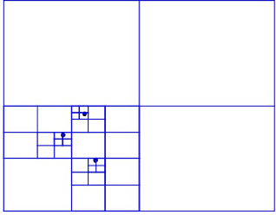
Quadtree data structure
Dividing space into 2x2 blocks
Assumption: A group of objects far enough from current object could be considered as a big single object.
Their gravitational force directions are nearly the same.
The distance threshold has trade-off:
If threshold is too small, program run faster, with lower accuracy.
If threshold is too large, program run slower, with higher accuracy.
If threshold is infinite, program become brute force solution.

Slide 12
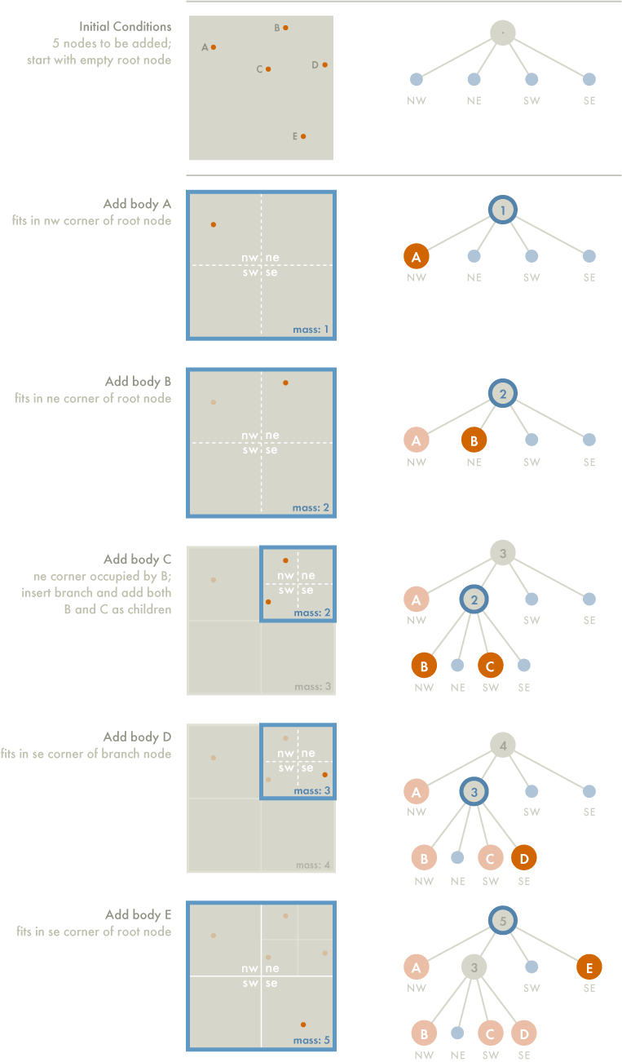
Constructing Quadtree

Slide 13
Constructing Quadtree

Slide 14
Constructing Quadtree

Slide 15
Constructing Quadtree

Slide 16
Constructing Quadtree

Slide 17
Constructing Quadtree

Slide 18
Calculating The Force
Calculating force on body A
If current node is external node (and not body A):
Calculate force affected by current node on A
Add this amount to A's net force
Otherwise, calculate ratio s/d
If s/d < θ (set θ = 0.5):
Treat internal node as single body
Calculate force it exerts on body A
Add this amount to A's net force
Otherwise:
Run procedure recursively on each of current node's children

Slide 19
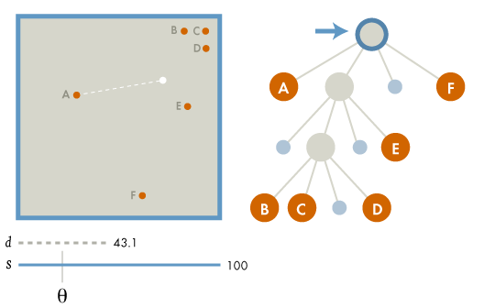
Calculating The Force
s/d = 100/43.1 > 0.5

Slide 20
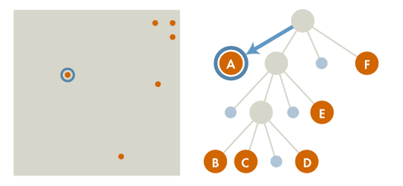
Calculating The Force

Slide 21
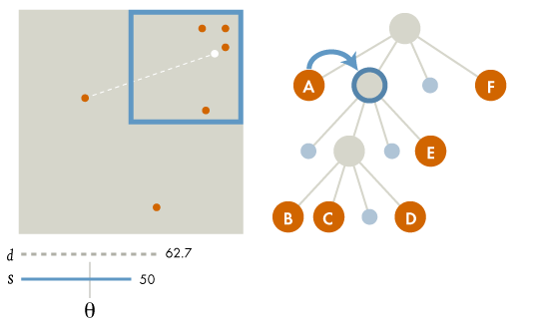
Calculating The Force
s/d = 50/62.7 > 0.5

Slide 22
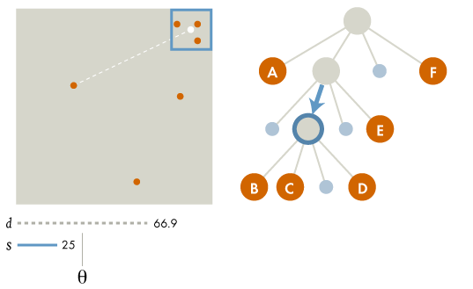
Calculating The Force
s/d =25/66.9 < 0.5

Slide 23
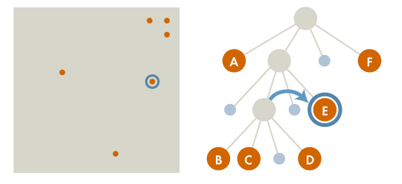
Calculating The Force

Slide 24
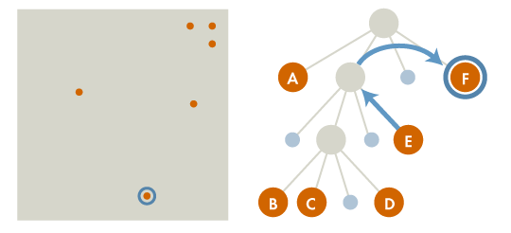
Calculating The Force

Slide 25
Outline
Problem Definition
How to formulate logic in terms of physics?
Proposal
Experiment Results

Slide 26

Demo

Slide 27
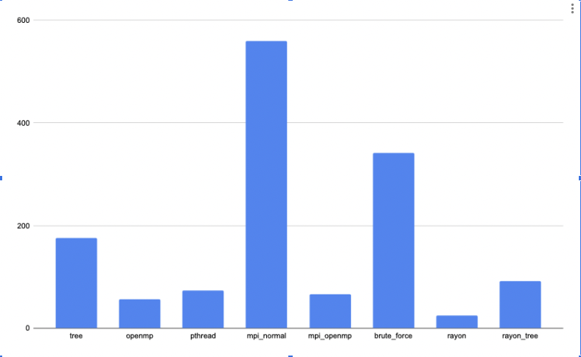
Experiment Result

Slide 28
OpenMP
It provides a straightforward and adaptable way to parallelize code.
OpenMP can be used to parallelize the force computation and integration phases in N-body simulations.
It enables effective use of multi-core processors.
OpenMP requires minimal code alterations and can be introduced incrementally.
It provides dynamic load balancing to ensure an efficient distribution of work among processor cores.
OpenMP is beneficial even when dealing with irregular or unpredictable workloads.

Slide 29
Rayon
Rayon is a data-parallelism library tailored for Rust programming language.
It enables parallel processing through high-level abstractions like parallel iterators and parallel scopes.
Rayon is built to cooperate with Rust’s type system and ownership model to ensure safe and efficient parallelism.
Rayon can be employed in N-body simulations to parallelize the force computation and integration phases.
Rayon smoothly integrates with Rust, providing a more idiomatic and secure parallelism experience.
Rayon’s work-stealing scheduler ensures dynamic load balancing, resulting in effective use of processor cores.

Slide 30
Message Passing Interface
MPI allows processes on different nodes to communicate and synchronize via message passing, which is crucial for extensive N-body simulations spanning multiple compute nodes.
MPI can be utilized in N-body simulations to distribute the workload across multiple nodes.
Each node handles a subset of the celestial bodies.
By implementing domain decomposition and effective communication schemes, MPI can substantially enhance the scalability and performance of the simulation, especially for large-scale systems.

Slide 31
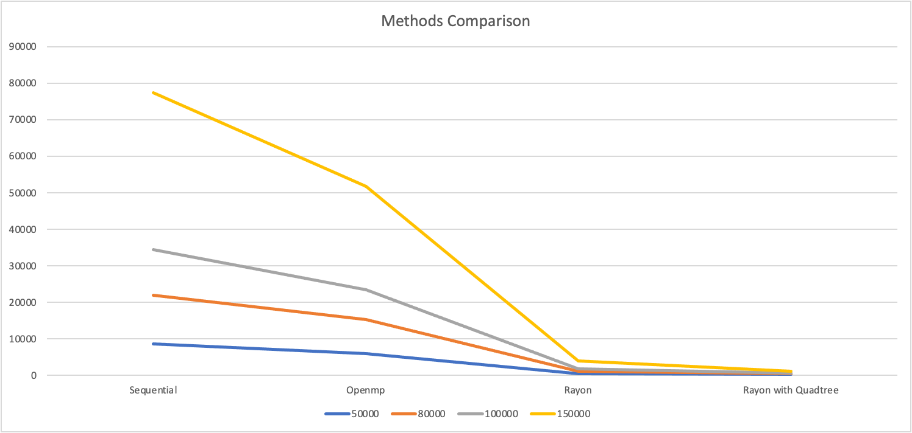

Slide 32
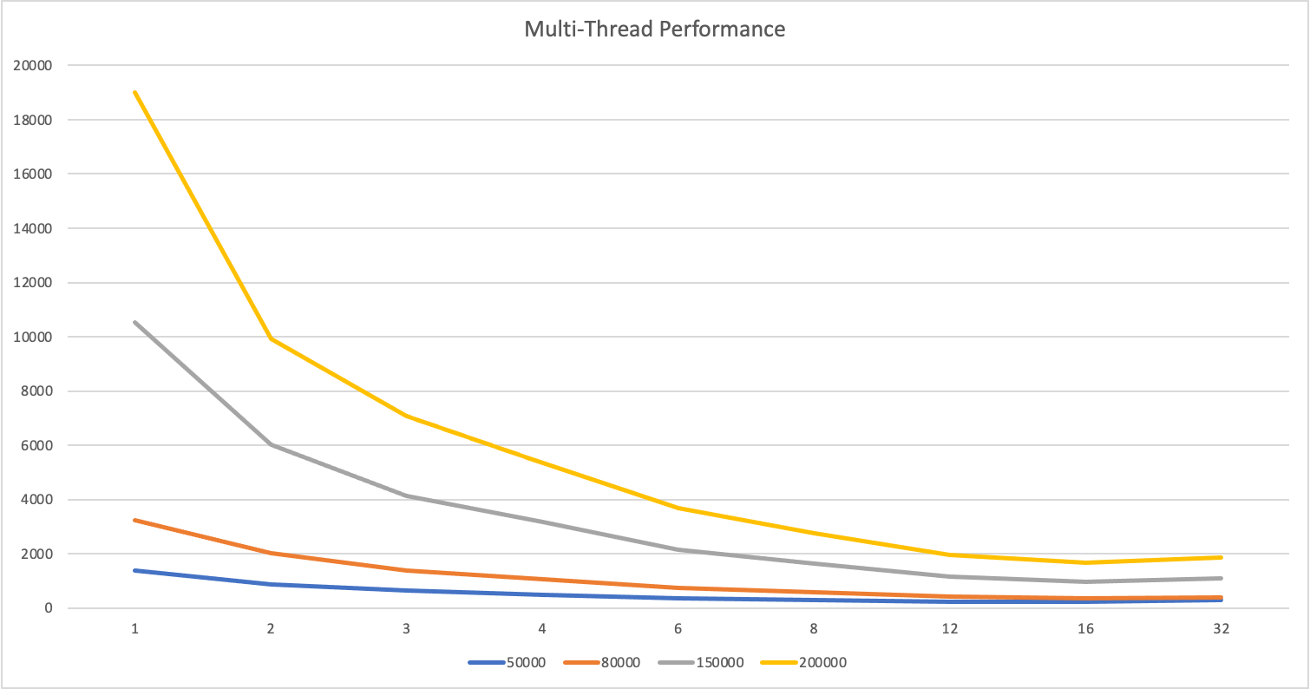

Slide 33
Future Work:
Hybrid parallelism
Load balancing
Adaptive time stepping
GPU acceleration
Energy efficiency

